Slide 1

Zoom
A Primer on Zoom Features for Every Meeting

Slide 2
zoom
Zoom Video Communications, Inc. (commonly shortened to Zoom, and stylized as zoom) is an American communications technology company headquartered in San Jose, California. It provides videotelephony and online chat services through a cloud-based peer-to-peer software platform used for video communications (Meetings), messaging (Chat), voice calls (Phone), conference rooms for video meetings (Rooms), virtual events (Events) and contact centers (Contact Center), and offers an open platform allowing third-party developers to build custom applications on its unified communications platform (Developer Platform).^{[1][2]}

Slide 3
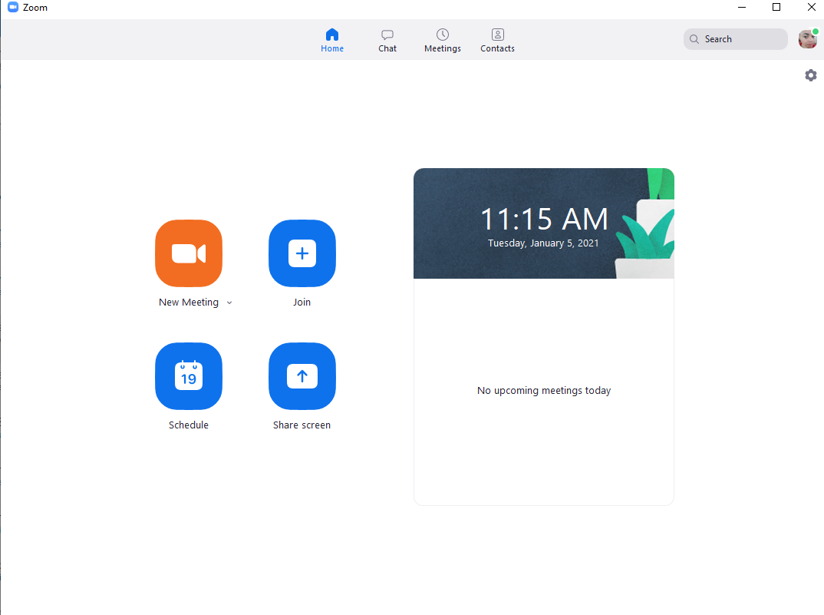
Home Screen
For list of all meetings at-a-glance (if integrated with Outlook)
Opportunity to create instant meetings, join meetings with a room number and passcode, or schedule meetings
Gear in upper right hand corner to access application settings
Picture or initials in uppermost right hand corner shows what account is logged in

Slide 4
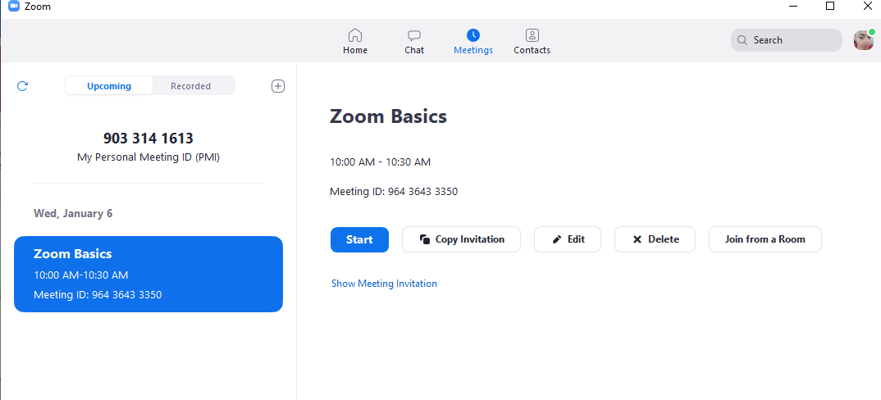
Your Meetings
Easy access to Personal Meeting ID
List of any scheduled meetings that you’ve created
Can edit meetings from this screen
Can send out invitation from this screen

Slide 5
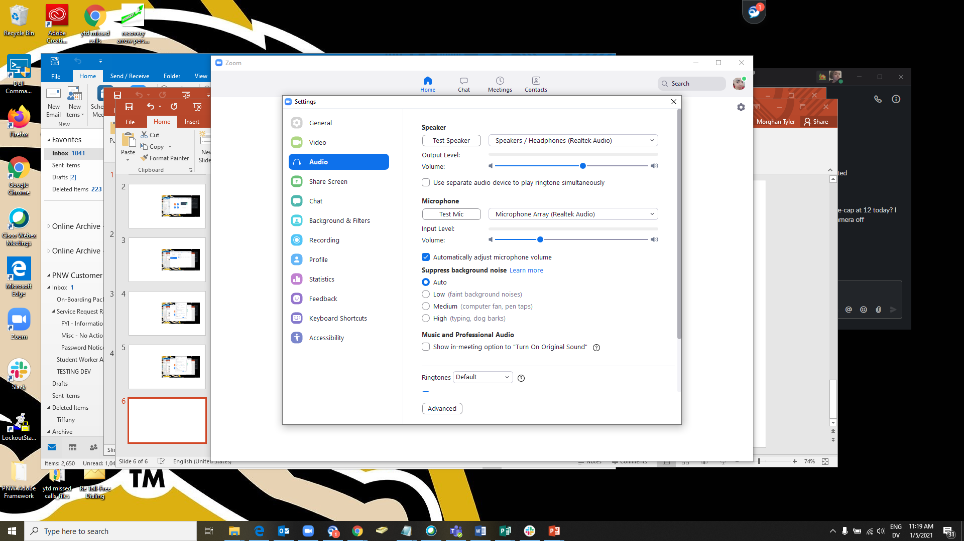
Settings in Application
From gear in upper right hand corner of home screen of the application
Allows most changes about the function of the application
Audio settings for testing microphone and speakers
Adjust video settings for how it displays in your meetings
Edit where and how you record your meetings

Slide 6
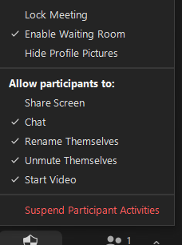
Security Settings
Settings also found in the gear on the main page as well as zoom.us
Easy click on/off for settings in the meeting if changes need to be made on the fly
To prevent ‘Zoom Bombing’, strongly suggest to consider who has the ability to share screens in meetings
Enabling a waiting room or a passcode is mandatory for all meetings to prevent security concerns
Suggest creating a co-host if you need assistance monitoring who is in the waiting room or maintaining security settings.

Slide 7
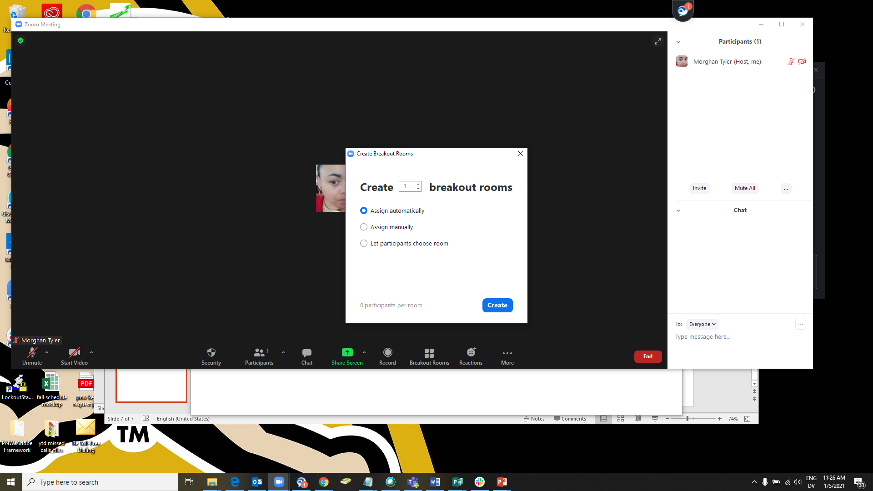
Breakout Rooms
Breakout Rooms can be created during a meeting or via zoom.us when scheduling a meeting
Choices are available for manual or automatic assignment

Slide 8
-THANK YOU FYIT 105 DURGESH MITHA
.

